Slide 1

Food Traceability using Blockchain
Johannes Ahlmann, CTO
johannes@claru.io
May 30th 2018

Slide 2
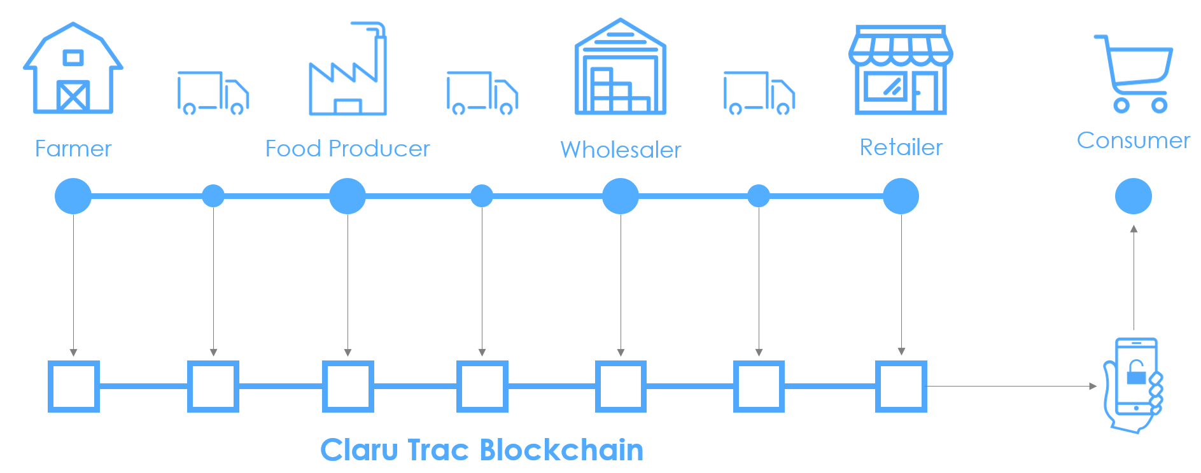

Claru Food Traceability
claru.io

Slide 3
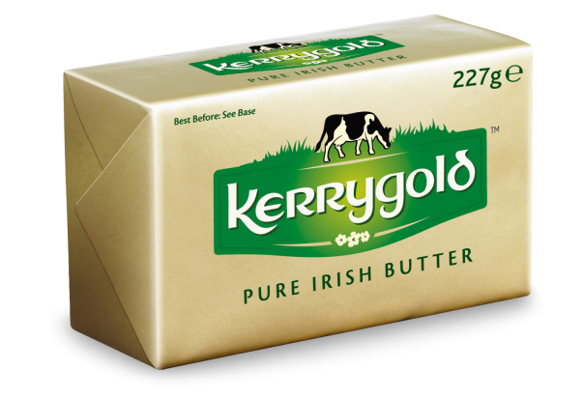
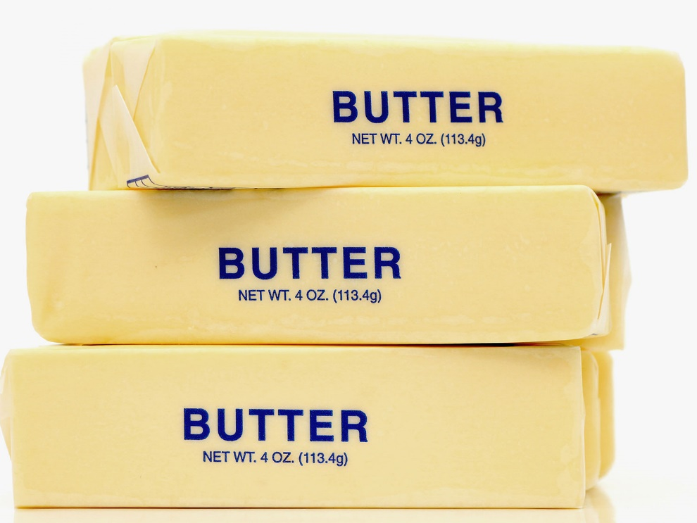
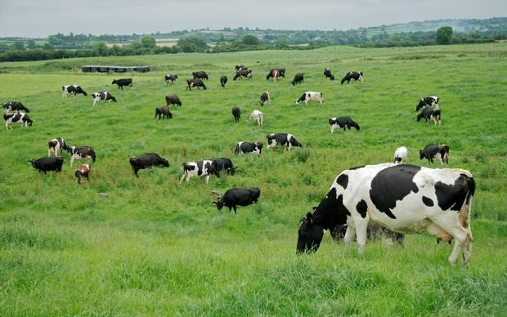
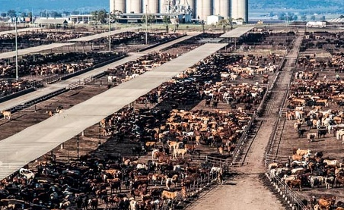
Good Food Doesn’t stand a Chance!
claru.io

Slide 4
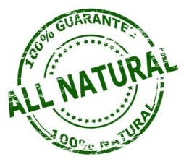



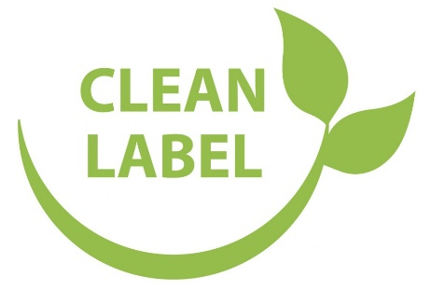
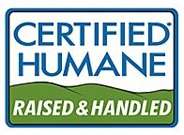


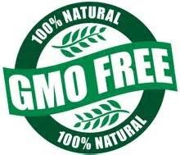
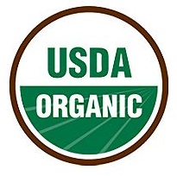

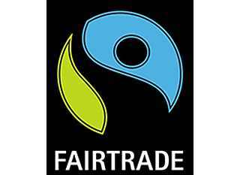

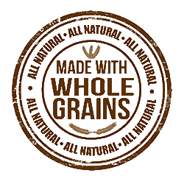
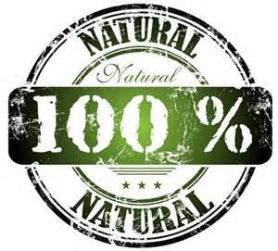

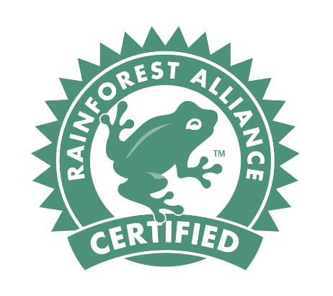
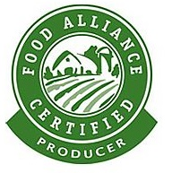
Consumers are overwhelmed by Marketing Noise
claru.io

Slide 5
Consumers Demand more Transparency
source: LabelInsight
source: LabelInsight
source: FoodThink - Building Trust in what we Eat (2013)
claru.io

Slide 6
Producers need more Transparency
Analytics
Traceability
Compliance
Food Supply Chain
Integration
Certification
Food Safety
claru.io

Slide 7

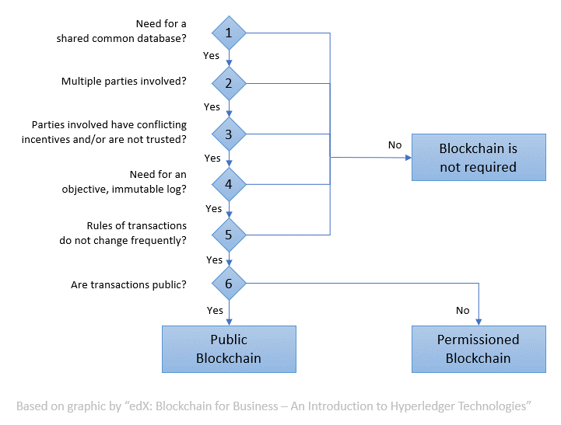

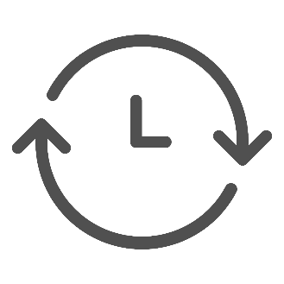

Blockchain for Supply Chain Traceability
Trust
Transparency
Real-Time
Tamper-Resistance
claru.io

Slide 8
A Consortium Blockchain can address some Challenges Companies may find with Public Blockchains
Public | Consortium
Data is Public | Privacy, Confidentiality
Transactions are Public | Private Channels
Pseudonymous | Known participants
Anyone can join | Permissioned
Anyone can access | Permissioned
Trustless Nodes | Semi-Trusted Nodes
Low tx/s | High tx/s
Unlikely GDPR Compliance | GDPR Compliance
Group of known, semi-trusted parties
Access granted by members
Consensus ~ majority vote (BFT)
Consensus can withstand 1/3 of malicious nodes
Data Storage
Easier Governance
claru.io

Slide 9



Consortium Blockchain Options
Hyperledger
Linux Foundation, Open Source
Fabric (IBM)
Kafka orderer, key-value store
Go, Java
Federated Channels, Private transactions
Sawtooth (Intel)
larger networks, PoET
transaction families
Composer
Quorum (JP Morgan Chase)
RAFT, Istanbul BFT
Ethereum fork
Privacy, Confidentiality
claru.io

Slide 10
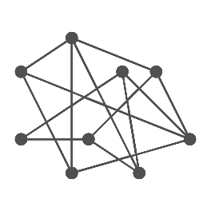



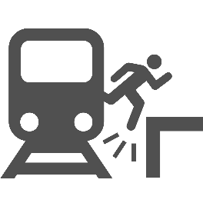

Challenges for Blockchain Adoption
Distributed Systems
Authentication of Participants
Multi-party Rollout
GDPR
Physical-Digital Gap
Fragmentation
claru.io

Slide 11
Consortium Blockchain Details
BFT - Minimum of 4 nodes required
PBFT (Fabric 0.6)
limited to 20-30 nodes (per channel)
PoET (Sawtooth)
scales to hundreds of nodes
Systems Integration requires significant effort
Governance needs to be in place to manage PII exclusion
Onboarding Government and NGO participants/nodes
Authentication via mail to registered company address
claru.io

Slide 12







Adoption - Many Pilot Projects Underway
Walmart | pilot for traceability of mangoes
Nestlé, Walmart, Costco, etc. | Consortium to identify blockchain use cases.
TE-Food | Migrating its at-scale solution for animal products
Chinese e-retailer JD.com | Enhance food traceability & safety in China
CBH | Executing Grain contracts
Honeysuckle White | Trace turkey back to the farm
Carrefour | Traceability of honey, eggs, cheese, milk, oranges, tomatoes, salmon and hamburgers
claru.io

Slide 13
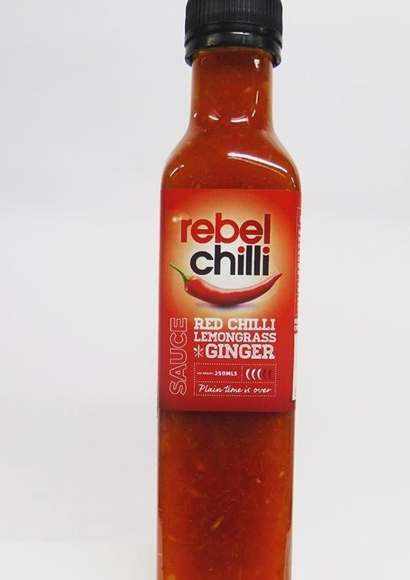
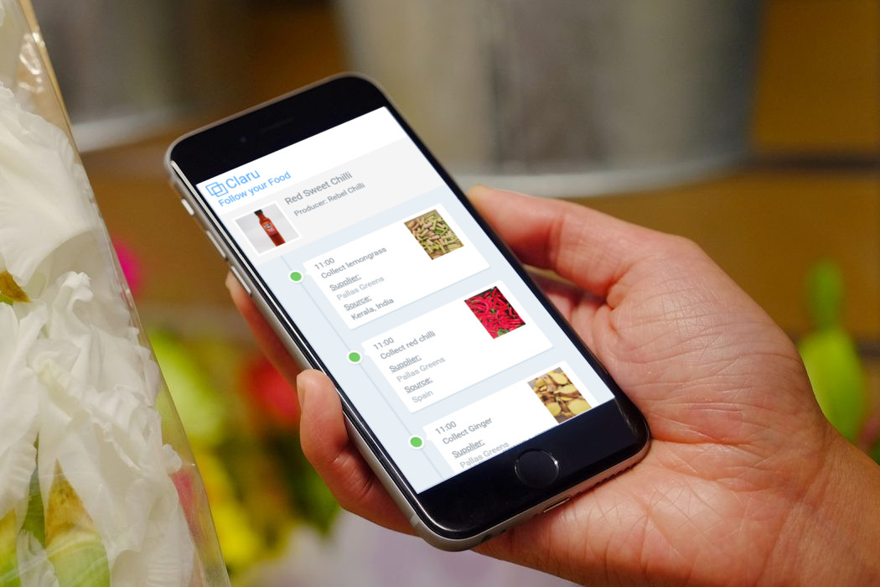
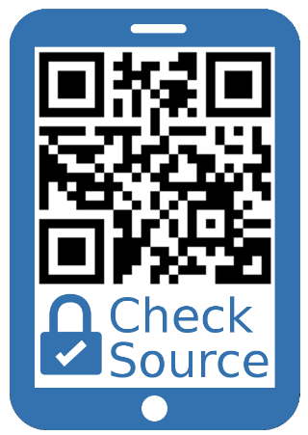
Pilot with Rebel Chilli
claru.io

Slide 14


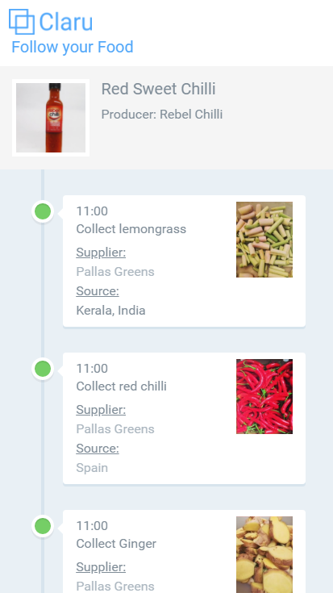
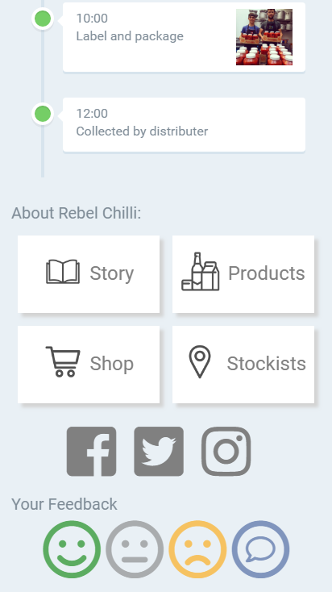
Follow your Food
claru.io

Slide 15
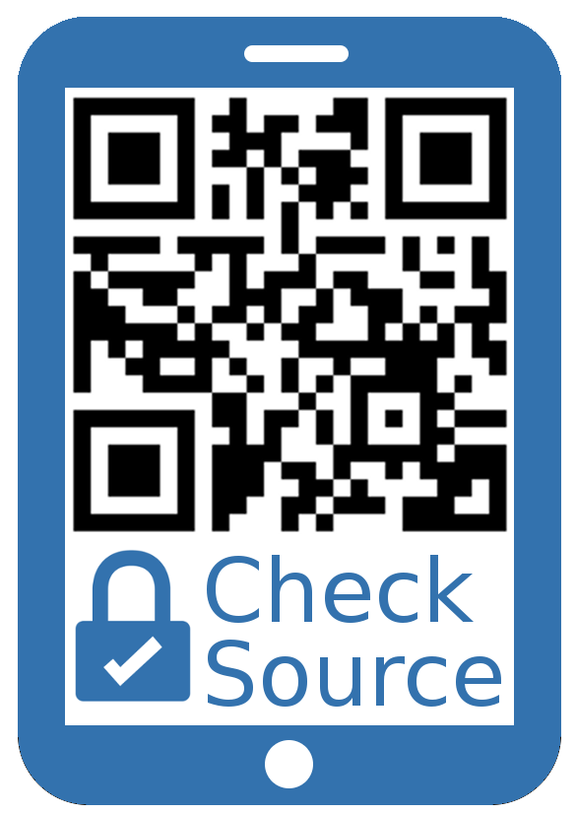
Thank you, any questions?
johannes@claru.io
claru.io

